Slide 1


NASA INTERNATIONAL SPACE APPS CHALLENGE 2023
ARTEMIS II
AND
YOU!
PRESENTED BY
THE LUNAR VISIONARIES TEAM
7TH-8TH OCTOBER 2023

Slide 2
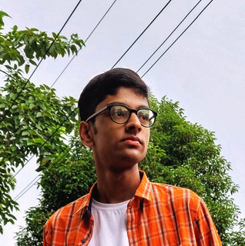
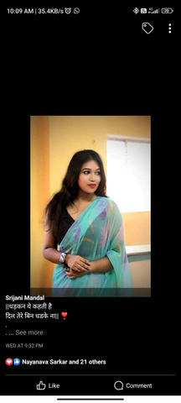
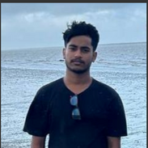
MEET OUR TEAM- THE LUNAR VISIONARIES
TEAM
MEMBERS
NILADITYA KAR (TEAM LEAD)
4
SRIJANI MONDAL
ARNAB DAS

Slide 3

TO MAKE A BRIEF VIDEO THAT COMMUNICATES HOW THE DEVELOPMENT OF THE ARTEMIS II MISSION WILL IMPACT US AND OUR COMMUNITY.
Objectives:-

Slide 4
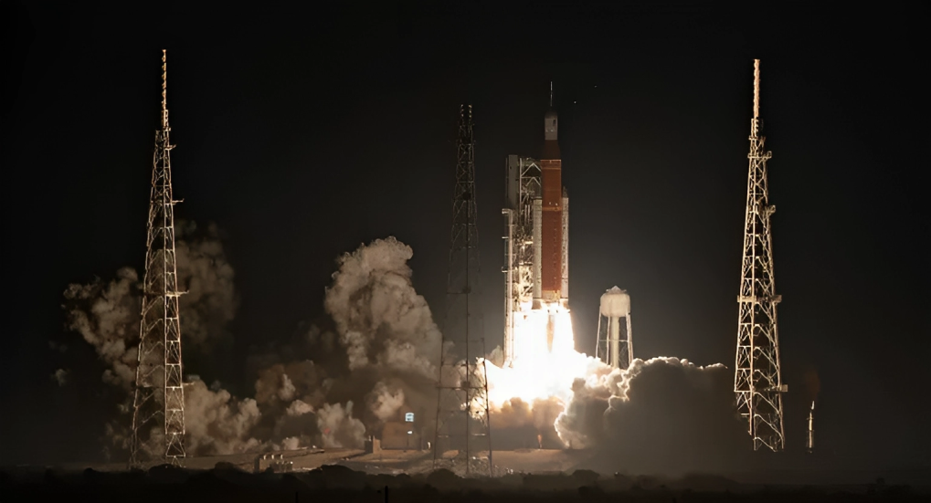
BACKGROUND
NASA’s Artemis II mission will bring a lot of firsts to the world–it will be the first mission to send a woman, a person of color, and a Canadian to lunar space.
We’re going back to the Moon for scientific discovery, economic benefits, and to inspire a new generation of explorers: the Artemis Generation. The Artemis Generation represents people across the world who will band together to explore deep space for the benefit of all.

Slide 5

CHALLENGE
Our challenge is to make a brief video (three minutes or less) that communicates how the development of the Artemis II mission is impacting us and our community.

Slide 6
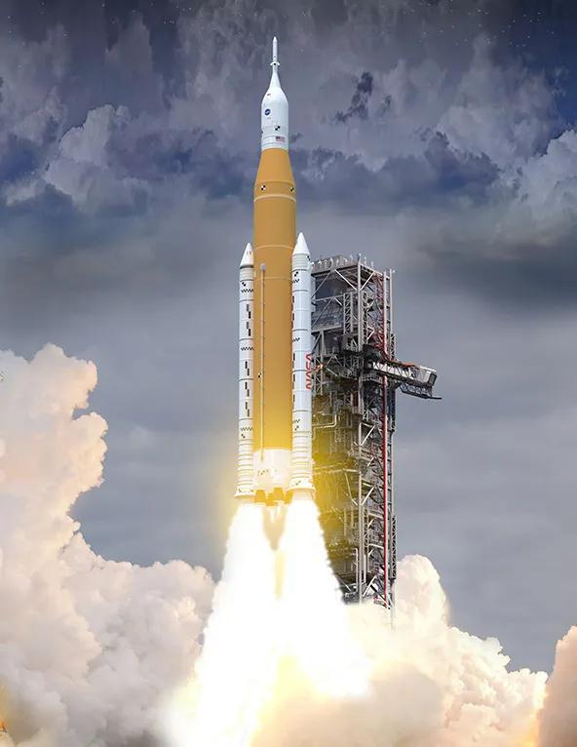
HOW ARE WE TACKLING THE CHALLENGE?
# 1
We have created a website containing the Landing Page, Video Page and Team Page in HTML and CSS using VS Code. Then, We have used Tailwind CSS to add CSS Elements in each of the webpages. The Landing Page contains Gallery of Artemis II related Images, Background and About the Mission. The Video Page contains the actual content of the Project, i.e, the Video explaining the Artemis II Mission, and the Team Page discusses about our Team.
# 2
We have edited the Video that will give us the Insights about the Mission on Filmora, exported it and then embedded the video in the Video Page in .mp4 Format.
# 3
Finally, We created a Repository on GitHub, uploaded our Project and then Hosted the Website using GitHub Pages.

Slide 7
1
OUR PROJECT WILL MAKE PEOPLE AWARE OF THE MISSION, MAKE THEM REALISE THAT THEY ARE PART OF THE ARTEMIS GENERATION.
SCOPE OF OUR PROJECT
2
ANYONE CAN ACCESS OUR PROJECT, PROVIDED THEY HAVE OUR SITE LINK, WATCH THE VIDEO THAT EXPLAINS EVERYTHING ABOUT THE MISSION IN SIMPLE AND CONCISE MANNER.

Slide 8
Resource Page
1 | GITHUB REPOSITORY: https://github.com/Niladitya-coder/artemis2-and-you.git
2 | PROJECT SITE: https://niladitya-coder.github.io/artemis2-and-you/
YOU CAN ACCESS OUR PROJECT SITE AND OUR CODE FROM HERE:

Slide 9
THANK YOU FOR YOUR KIND COOPERATION!

